Slide 1
END USER TRAINING
DEPARTMENT OF BIOMEDICAL

Slide 2

AGENDA
FLOW METER
SUCTION APPARATUS
Dual Gauge O2 Regulator

Slide 3
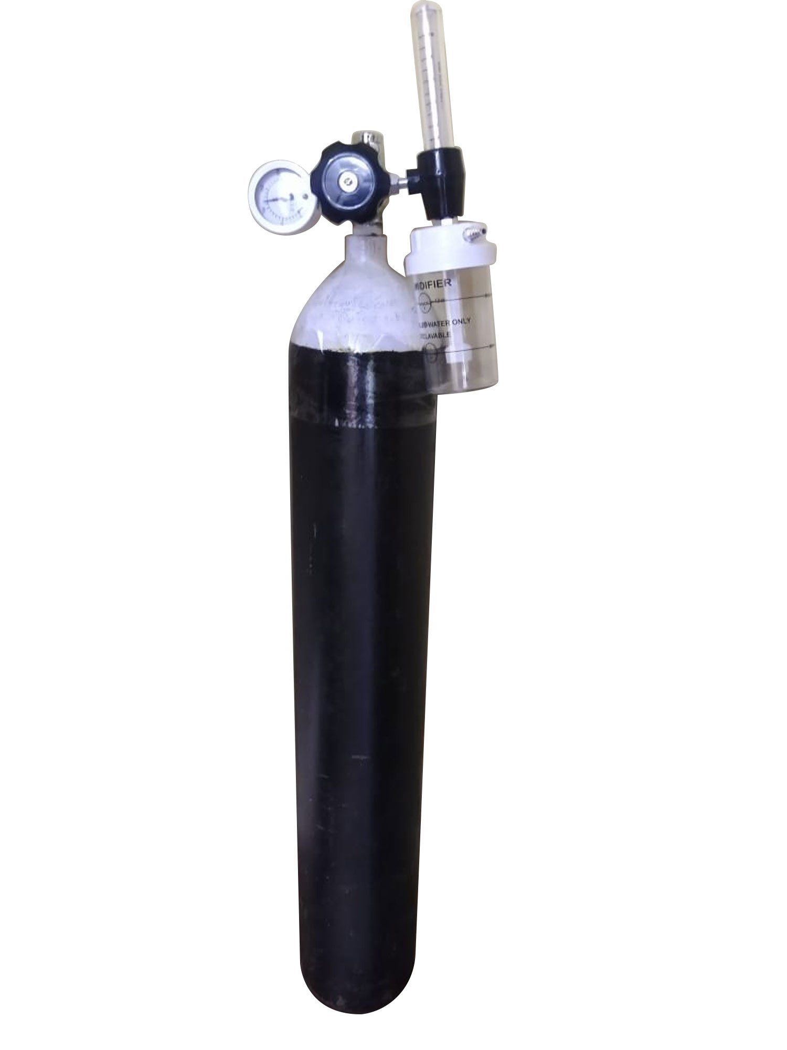
Oxygen (O2) cylinders
Overview
Oxygen (O2) cylinders are critical in medical settings for delivering oxygen to patients. Safe handling is essential to prevent accidents, such as leaks, fire hazards, or equipment damage.
Best Practices for Handling O2 Cylinders:
Storage:
Store cylinders upright in a well-ventilated area, away from heat and direct sunlight.
Use cylinder racks or chains to secure them to prevent tipping.
Keep full and empty cylinders separated and clearly labeled.
Transporting Cylinders:
Always use a cylinder cart or trolley designed for oxygen cylinders.
Ensure the valve is closed, and the regulator is removed before transporting.
Do not drag, roll, or carry the cylinders by hand.

Slide 4
4. Connection and Use:
Before use, check the cylinder for any signs of damage, such as rust, cracks, or leaks.
Attach the regulator carefully and ensure the connection is secure.
Open the valve slowly to avoid rapid pressurization, which could cause damage.
5. Precautions:
Fire Safety: Oxygen promotes combustion, so keep cylinders away from open flames, sparks, or smoking areas.
Handling Under Pressure: Never tamper with or modify the cylinder or its valve. Ensure the pressure gauge and regulator are in good working condition.
Avoid Oil and Grease: Do not handle cylinders with oily hands or gloves, as oil can react violently with oxygen, causing a fire or explosion.
6.Inspection and Maintenance:
Perform regular inspections of the cylinder, valve, and regulator for wear or damage.
Replace or service faulty components immediately.
7.Emergency Protocols:
In case of a leak or emergency, immediately remove the cylinder from the area, close the valve, and inform the appropriate personnel.

Slide 5
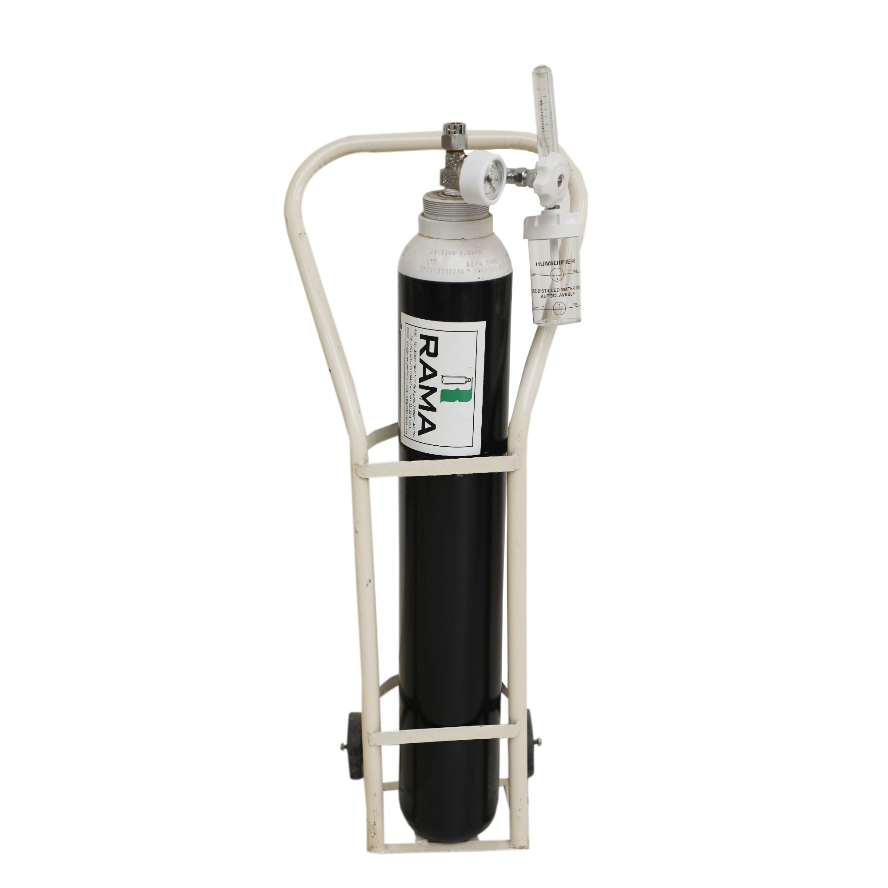
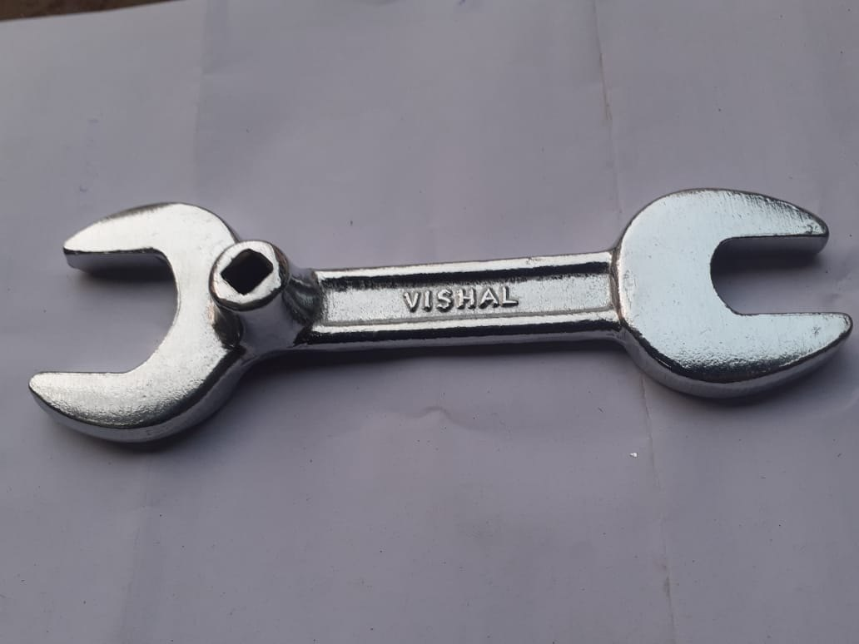
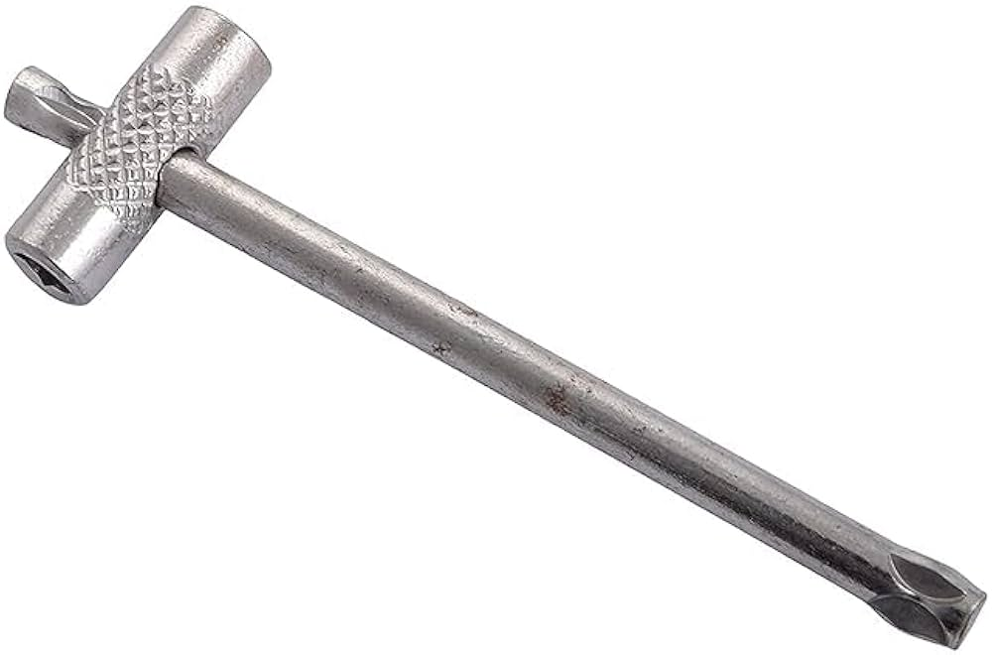
Common Mistakes to Avoid:
Storing cylinders improperly (e.g., laying them down or in unsafe locations).
Ignoring damaged or worn cylinders.
Failing to close the valve after use, leadingto potential leaks.
“ALWAYS USE PROPER TOOLS"

Slide 6
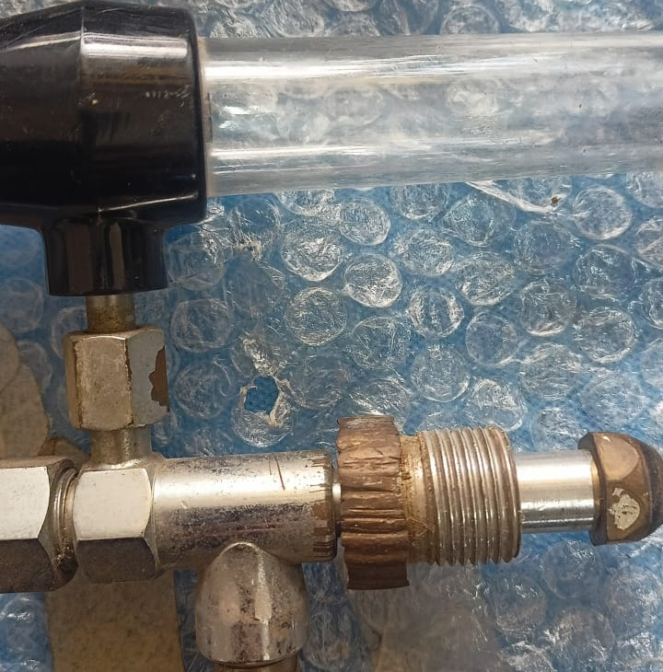

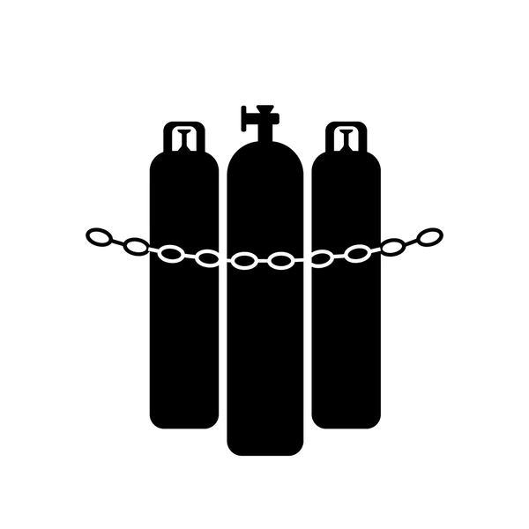

Slide 7
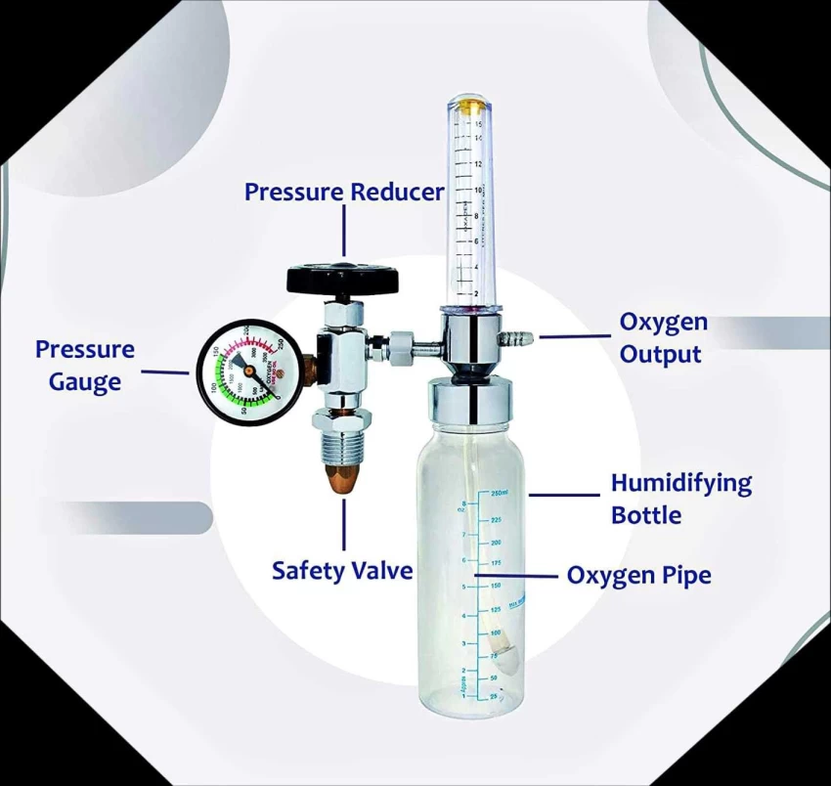
FLOW METER
Flowmeter Overview
A flowmeter is a medical device used to measure and regulate the flow of gases, such as oxygen, from a source to a patient. It helps ensure that the right amount of gas is delivered for treatment.
Basic Components:
Control Knob: Adjusts the flow rate of gas.
Flow Indicator: Shows the rate at which gas is flowing, usually in liters per
minute (LPM).
Tubing Connectors: Connect the flowmeter to gas sources or humidifiers.
Pressure Gauge: Monitors the pressure to ensure the flow rate is consistent.
Humidifier: Optional but used to add moisture to the gas, preventing dryness
and irritation for patients receiving long-term oxygen therapy.

Slide 8
Cleaning and Disinfection of Flowmeters
Proper cleaning and disinfection of flowmeters are essential to prevent infection and ensure the device functions correctly.
Steps for Cleaning:
1.Disassemble the Flowmeter: Carefully take apart the flowmeter, including removing the tubing, connectors, and any detachable components like the humidifier
2. Rinse with water: Use warm water to rinse away any visible dirt or debris from all parts of the flowmeter.
3. Use Mild Detergent: Wash all components with a mild detergent. Make sure to scrub gently to avoid damaging sensitive parts like the flow indicator
4. Rinse Thoroughly: After cleaning with detergent, rinse all parts with clean water to remove any soap residue.
5. Dry Completely: Allow all components to air-dry on a clean surface or use a clean towel. Ensure no moisture remains, especially in tubing and connectors, which could lead to bacterial growth.
6. Reassemble the Flowmeter: Once dry, reassemble the flowmeter, checking that all parts are secure and in working condition.

Slide 9

LIVE - DEMO
How to connect a flowmeter
Safety Tips
Common Mistakes
DOS
Don’ts

Slide 10
SUCTION APPARATUS
Overview
A suction apparatus is a medical device used to remove mucus, fluids, or foreign materials from a patient’s airway or body cavities. It plays a crucial role in maintaining airway patency, particularly in emergency and surgical settings
Key Components:
Collection Chamber: Holds the suctioned material for easy disposal.
Tubing: Connects the collection chamber to the suction source and delivers suction to the patient.
Control Valve: Regulates the suction pressure and flow rate.
Filter: Prevents contaminants from entering the pump.

Slide 11
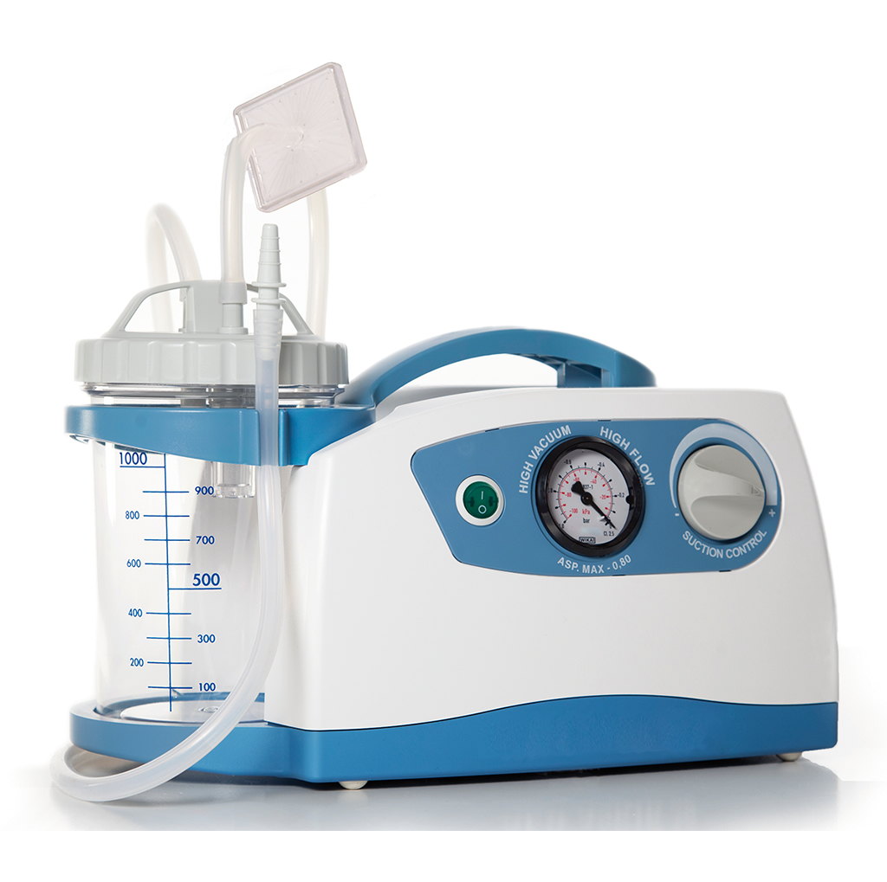
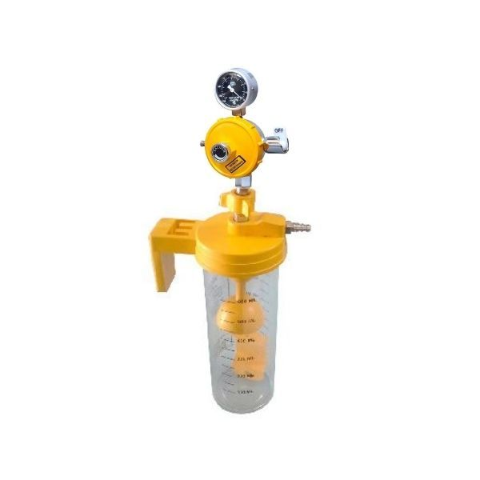
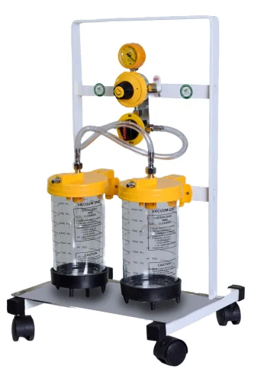
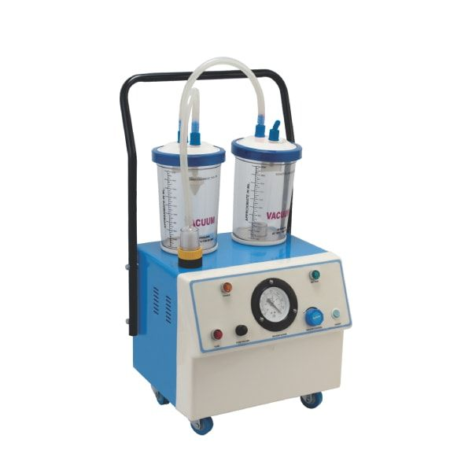
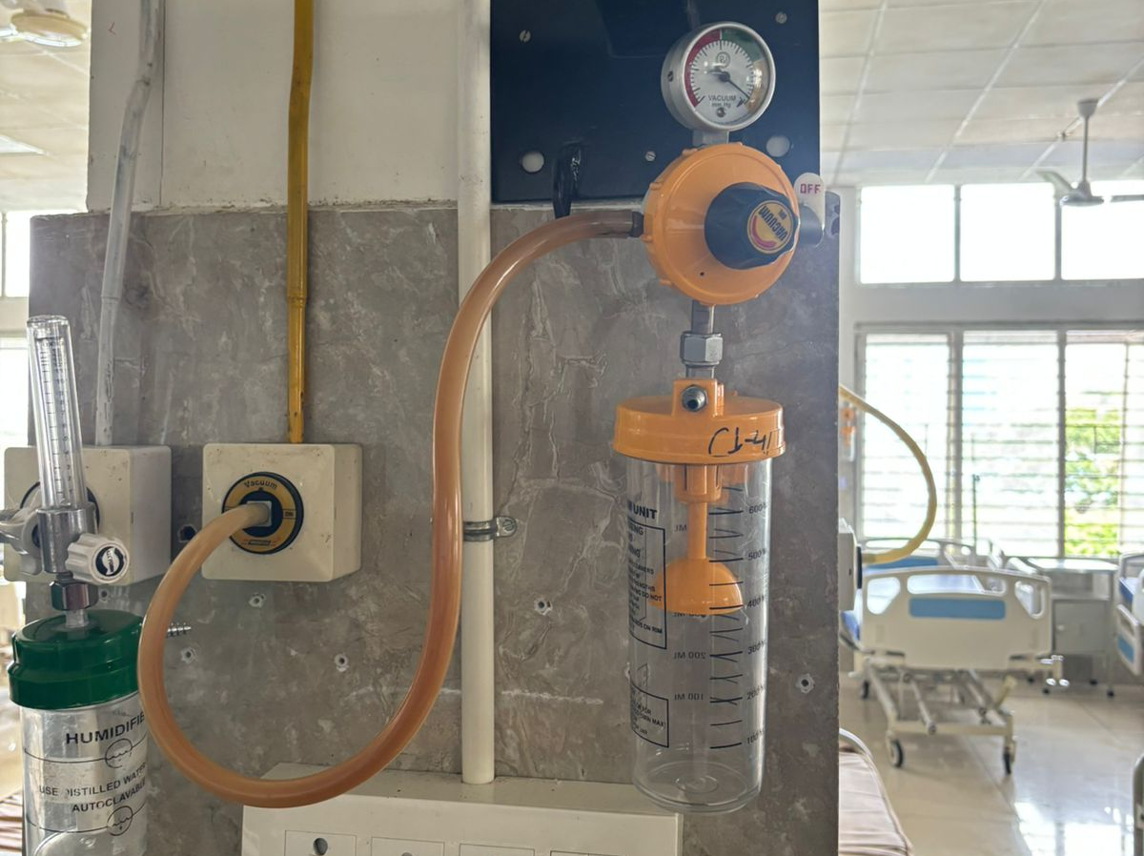
DIFFERENT TYPE OF SUCTION APPARATUS
Electric suction machine
Central suction

Slide 12

Cleaning and Disinfection of Suction Apparatus
Regular cleaning and disinfection of suction apparatus are vital to prevent infections and ensure the safety of patients. Contaminated equipment can harbor pathogens, leading to healthcare-associated infections
Steps for Cleaning:
1.Gather Supplies:
Mild detergent or enzymatic cleaner
Soft cloths or sponges
Gloves
Clean water
Disinfectant approved for medical use
2. Prepare the Apparatus:
Turn off and unplug the suction unit.
Disconnect all components (tubing, collection chamber, filters).

Slide 13
3. Initial Rinse:
Rinse the collection chamber and tubing with water to remove any visible debris.
4. Wash Components:
Clean the collection chamber and tubing with detergent or an enzymatic cleaner. Use a soft cloth or sponge to ensure all surfaces are scrubbed.
5. Rinse Thoroughly:
Rinse all components under running water to remove all detergent residue.
6. Drying :
Allow all components to air dry completely before reassembling.
Maintenance:
Regular Checks: Inspect the apparatus regularly for wear, damage, or signs of contamination.
Scheduled Cleaning: Establish a routine cleaning schedule based on usage frequency and manufacturer recommendations.

Slide 14

LIVE - DEMO
Parts
Common Mistakes
DOS
Don’ts

Slide 15
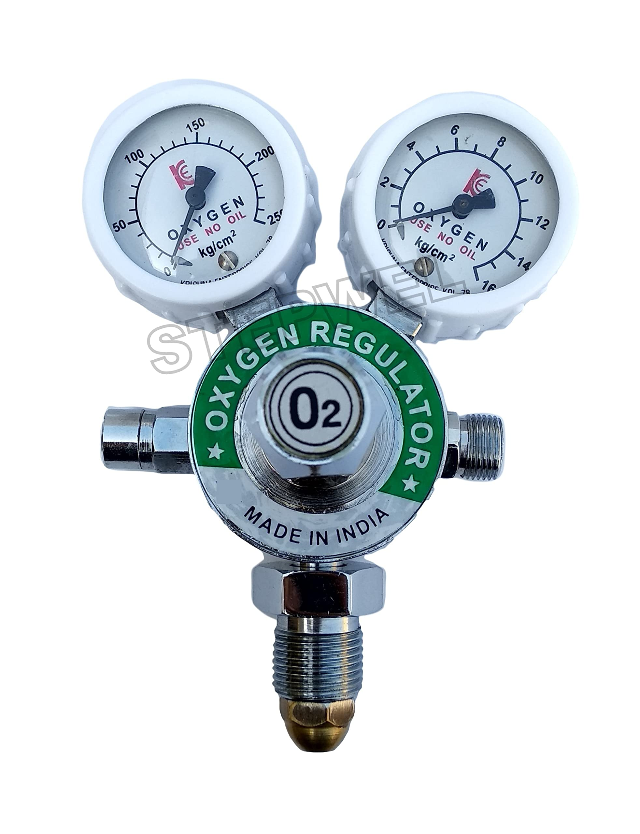
DUAL GAUGE O2 REGULATOR
Definition: A dual gauge O2 regulator is a device used to control the flow and pressure of oxygen from a tank to a patient or medical equipment. It features two gauges: one for measuring the tank pressure and the other for monitoring the flow rate of oxygen being delivered.
Key Components:
High-Pressure Gauge: Displays the remaining pressure in the oxygen cylinder, indicating how much oxygen is left.
Flow Rate Gauge: Shows the rate of oxygen flow, typically measured in liters per minute (LPM), allowing for precise adjustments based on patient needs.
Flow Control Knob: Used to adjust the flow rate of oxygen being delivered.
Connector: Attaches the regulator to the oxygen tank and provides a secure connection to the delivery device (e.g., nasal cannula or mask).
Safety Features: May include pressure relief valves to prevent over-pressurization.

Slide 16
Key points before patient shifting
MAKE SURE CYLINDER IS FULL AND HAVING
4 BAR PRESSURE
CHECK IF ANY LEAKAGE

Slide 17

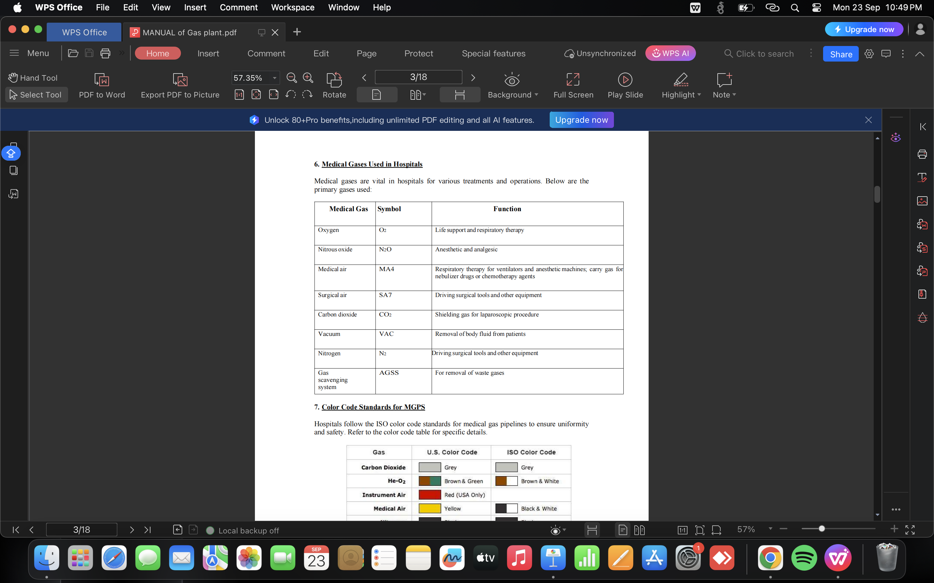
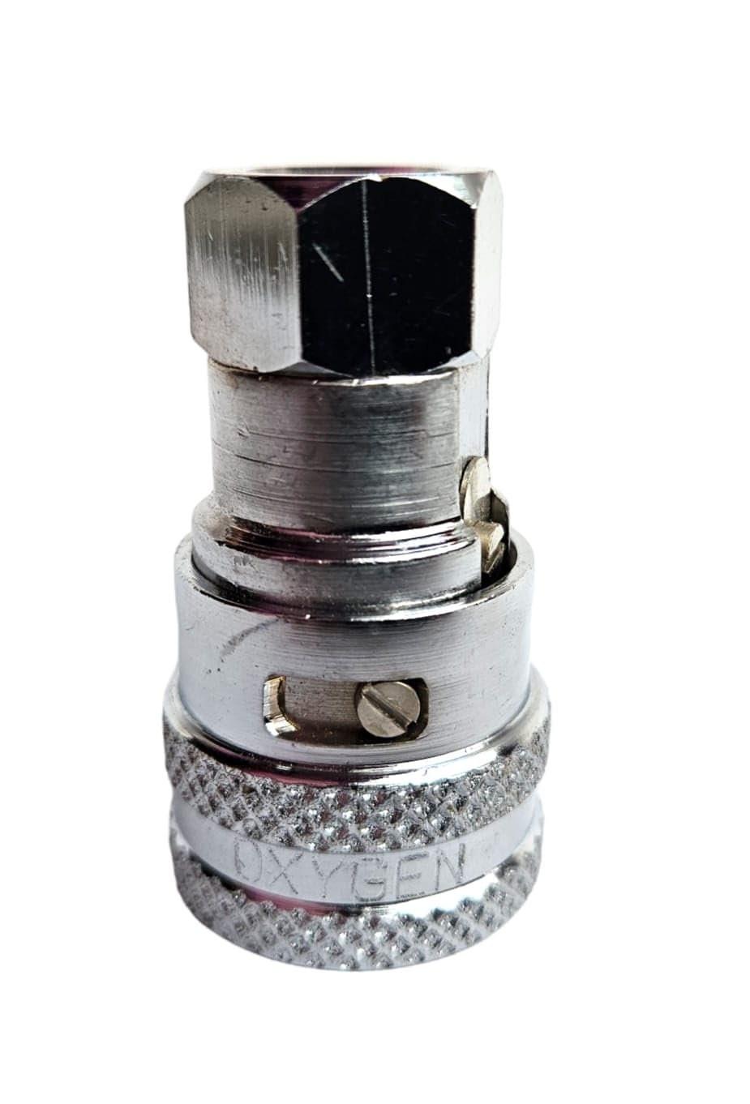
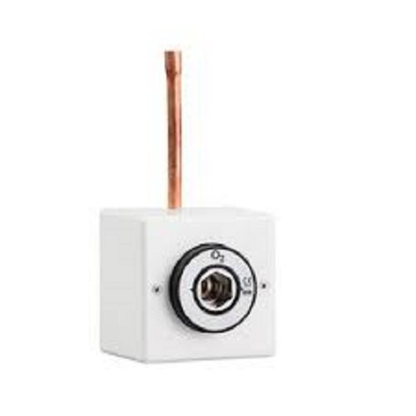
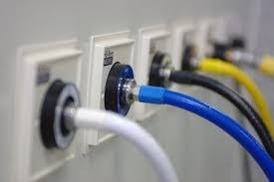
HOSPITAL GAS COLOR CODE

Slide 18


SCAN ME

